Slide 1
Multivariate Linear Regression Modelling in R
Submitted BY: Mansi

Slide 2
Case Study 1- The State Data
Objective: To build an analytical model to predict the life expectancy by state using the state statistics.
Business Problem: To analyse using the given State data that which all factors play a key role in predicting the life expectancy of the population of every state in the US.
And consequently interpreting the relationship between the significant factors and the life expectancy.

Slide 3
About the data
The state dataset has 50 observations from the 1970s, one for each of the 50 US States.
There is a total of 15 different variables which include:
1) population | 9) latitude
2) per capita income | 10) longitude
3) illiteracy rate | 11) division the state belongs to
4) murder rate | 12) region the state belongs to
5) high school graduation rate | 13) Life expectancy
6) average number of frost days | 14) Land area
7) area | 15) Full name of each state
8) two-letter abbreviation

Slide 4
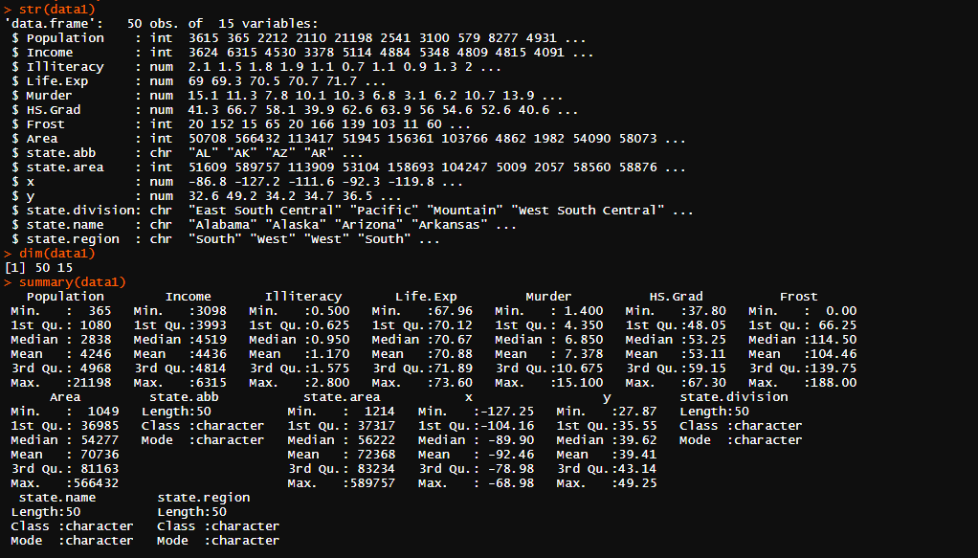

Descriptive Analysis
Here, it is is clear that there are 11 numerical variables out of 15. For all the numerical variables, we have statistical data like maximum, minimum, mean and median values which show us how the data is distributed, whether uniform or not. A large difference in mean and median represents the presence of outliers since median is not affected by outliers, unlike mean. Thus, “Population” definitely has outliers which should be treated. From the same data, range of all the variables can be found out by observing max and min.

Slide 5
Demographics of the US
From the pie diagram, we have the population distribution of various regions in the US. There are 50 states in total divided into 4 regions. Its clear that South region has the max population. Using the x and y coordinates, we have tried outlining its shape like a map.

Slide 6
Methodology
After the initial removal of redundant variables like abbreviation, full name and state area, we then check for outliers using the quantiles method. Since we have very less data, we don’t divide it into train and test. Hence, model training is done on the entire data. Next, we perform various iterations to remove the insignificant variables at 90% confidence level.
Finally, a model with just the significant variables is formed. Then we check the power of the final model by performing various diagnostic tests and check for multi collinearity and auto correlation.
Using the same model, we then predict for life expectancy values.

Slide 7
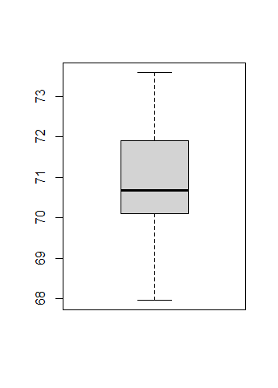
Removal of Outliers
The Quantiles method as well as the Box Plot clearly show us that there are no outliers in our dataset.

Slide 8
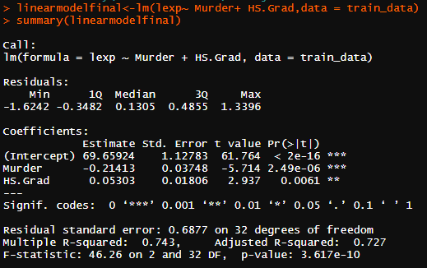
Statistical Interpretation
In the final model, we obtain two significant variables namely Murder and HS Grad, at 99% confidence level. The R2 value is 0.743 which means that 70% of variations in Lexp can be accurately explained by our variables. P-value is significantly low implying that the variable is very significant for deciding the life expectancy.

Slide 9
Predicted v/s actual life expectancy values
We see very minute variations between the two which implies that our model worked well enough in predicting the values.

Slide 10
Business Interpretation
From the multivariate linear regression model, we come to know that “HS Grad” and “Murder” affect the life expectancy with estimates being 0.05 and -0.21 respectively, where “HS Grad” is the percent of high school graduates and “Murder” is the murder and non-negligent manslaughter rate per 100,000 population.
From here we can interpret that for every 1 unit increase in HS Grad, the life expectancy increases by 0.05 times, however, for every one unit increase in Murder, the life expectancy decreases by 0.21 times.

Slide 11
Recommendations
Observations from the model tell us that to set up any business which involves older people, one must move towards West since that region has states having larger HS Grad values. .
On the same lines, to set up a business that involves younger people, one must move towards South, since that region has states having lower HS Grad values.
Similar, but opposite, propositions can be made while considering Murder.

